Slide 1
Defects are deviations from perfect crystal structure that play a crucial role in mechanochemical reactivity
Point defects (0D):
Vacancies, interstitials, substitutional impurities, Frenkel and Schottky defects
Line defects (1D):
Edge dislocations, screw dislocations, dislocation loops
Planar defects (2D):
Grain boundaries, twin boundaries, stacking faults, external surfaces
Volume defects (3D):
Voids, pores, precipitates, cracks
Key concept: Defect concentration increases dramatically during mechanical treatment, creating active sites for chemical reactions

Slide 2
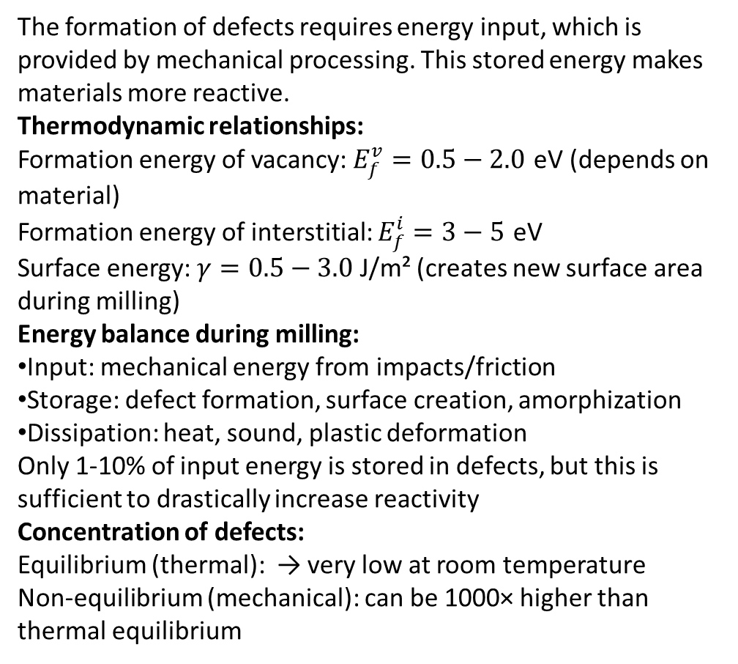
The formation of defects requires energy input, which is provided by mechanical processing. This stored energy makes materials more reactive.
Thermodynamic relationships:
Formation energy of vacancy: $E_{f}^{v}=0.5−2.0$ eV (depends on material)
Formation energy of interstitial: $E_{f}^{i}=3−5$ eV
Surface energy: $γ=0.5−3.0$ J/m² (creates new surface area during milling)
Energy balance during milling:
Input: mechanical energy from impacts/friction
Storage: defect formation, surface creation, amorphization
Dissipation: heat, sound, plastic deformation
Only 1-10% of input energy is stored in defects, but this is sufficient to drastically increase reactivity
Concentration of defects:
Equilibrium (thermal): → very low at room temperature
Non-equilibrium (mechanical): can be 1000× higher than thermal equilibrium

Slide 3
Mechanisms of increased chemical reactivity:
Local strain and lattice distortion:
Breaking of symmetry creates sites with altered electronic structure and lower coordination numbers. These sites have reduced activation barriers for reactions.
Increased surface area:
Particle size reduction: 10 μm → 10 nm increases specific surface area by ~1000×. More reactive surface sites become accessible.
Dangling bonds and radical sites:
Mechanical fracture creates fresh surfaces with unsaturated bonds (dangling bonds) that are highly reactive. These can act as radical centers or coordination sites.
Enhanced diffusion:
Defects serve as fast diffusion pathways. Grain boundary diffusion is 10²-10⁶ times faster than bulk diffusion. Enables solid-state reactions at lower temperatures.
Metastable phases:
Mechanical treatment can produce high-energy polymorphs, amorphous phases, or solid solutions that are thermodynamically unstable but kinetically trapped.

Slide 4
Progressive accumulation during mechanical treatment:
Stage 1 (initial): Elastic deformation, reversible
Stage 2 (continued): Plastic deformation, dislocation generation and multiplication
Stage 3 (extensive): High defect density, nanostructuring, partial amorphization
Stage 4 (over-milling): Possible phase transitions, complete amorphization, or agglomeration
Measuring stored energy:
Calorimetric methods (DSC): exothermic peak upon heating shows energy release
Typical stored energy: 5-50 kJ/mol (0.05-0.5 eV/atom)
Chemical reactivity tests: dissolution rate, reaction onset temperature
X-ray line broadening: microstrain and crystallite size
Relaxation processes:
Stored energy can be released through: recovery, recrystallization, grain growth, or chemical reactions. Time and temperature dependent.

Slide 5
Modern computational chemistry provides quantitative predictions of defect properties and their influence on reactivity.
Ab initio methods (DFT):
Calculate defect formation energies, charge states, migration barriers
Codes: VASP, Quantum ESPRESSO, CASTEP
Example: vacancy formation in MgO = 6.5 eV (DFT) vs. 7.0 eV (experiment)
Classical methods (Molecular Dynamics, Monte Carlo):
Simulate larger systems (10⁴-10⁶ atoms) over longer timescales
Interatomic potentials: Buckingham, embedded atom method (EAM), ReaxFF
Applications: dislocation dynamics, grain boundary structure
Multiscale modeling:
Coupling quantum mechanics (reaction site) with classical mechanics (bulk material)
QM/MM approaches for mechanochemistry
Machine learning:
Training neural networks on DFT data to predict defect properties rapidly
Accelerating materials discovery for mechanochemical applications
Challenges:
Capturing non-equilibrium, high-energy states
Simulating mechanical impacts at realistic strain rates

Slide 6
Main concepts:
Defects are essential for mechanochemical reactivity - perfect crystals are chemically inert at low temperatures
Mechanical processing creates high concentrations of non-equilibrium defects (point, line, planar, volume)
These defects store energy (typically 5-50 kJ/mol) that lowers activation barriers for reactions
Multiple mechanisms: increased surface area, strained bonds, enhanced diffusion, metastable phases
Both experimental (DSC, XRD, TEM) and computational (DFT, MD) tools are available to characterize and predict defect behavior
Understanding defect chemistry is the foundation for rational design of mechanochemical processes
Looking ahead:
Next lecture will explore thermodynamics and kinetics of mechanochemical reactions in detail

